Slide 1
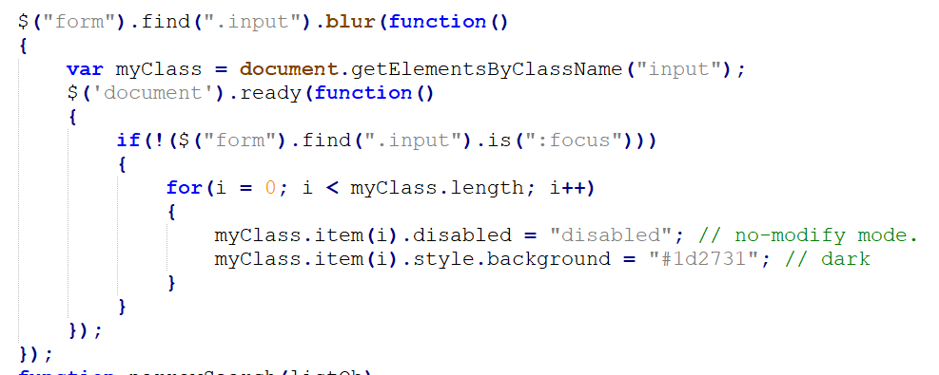
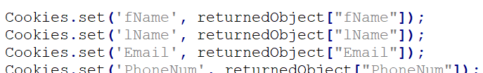
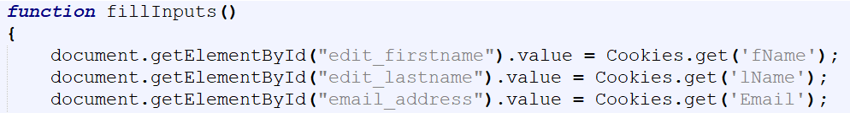
Front-End Functionality
Javascript
Jquery
Js-cookie

Slide 2



Jquery and js-cookie Source and Licensing
https://github.com/js-cookie/js-cookie
https://github.com/jquery/jquery
Both Released under MIT License

Slide 3

Front-end Functionality Challenges
Toggling Editing Mode
Browser Cache

